Slide 1
URBANIZATION OF URBAN AGRICULTURE IN VERTICAL FARMING
Team Members
M S SAISANKEET (RA2211004050001) A BRITTO (RA2211004050002)
Mentor
Dr MANIKANDAN
AP/ECE

Slide 2
ABSTRACT
Urban agriculture, particularly vertical farming, is emerging as a sustainable solution to meet the growing food demands in densely populated urban cities. Vertical farming utilizes limited spaces such as rooftops and building interiors to cultivate crops, making it ideal for space-constrained environments. However, challenges like air pollution, soil contamination, and changing climate conditions pose serious threats to crop health and productivity.
This project focuses on enhancing vertical farming practices in urban areas through real-time environmental monitoring. Using advanced sensors such as PM2.5, CO2, and NOx, the system detects harmful pollutants and chemical levels in the air and soil. These sensors are integrated with the STM32H755ZIQ Nucleo development board, which features a dual-core STM32H755ZIT6 microcontroller combining a high-performance Cortex-M7 and a power-efficient Cortex-M4, suitable for advanced embedded applications.
By continuously monitoring air quality and soil conditions, the system supports precision farming, enabling farmers to make data-driven decisions that optimize resource use and improve crop yield. This project aligns with India’s growing urban agriculture sector, which is expected to expand at a CAGR of 4.6% between FY20 and FY26. Ultimately, this solution promotes sustainable food production, better environmental management, and higher crop yields in urban vertical farming systems.

Slide 3
INTRODUCTION
Urban Agriculture & Vertical Farming: Vertical farming in urban areas is a sustainable method to grow food in limited spaces like rooftops and building interiors.
Challenge of Air Pollution: Environmental pollution, especially air pollution, can negatively impact plant growth and reduce crop yield in urban farms.
Project Objective: This project aims to monitor air quality in vertical farms using sensors to detect harmful pollutants such as PM2.5, CO2, and NOx.
Technology Used: The system uses an STM32 Nucleo board for efficient data processing and advanced sensors for real-time pollution and soil monitoring.
Smart Farming Integration: By combining air quality and soil data, the system improves decision-making, enhances crop health, and supports sustainable urban agriculture.

Slide 4
EXSISTING METHODOLOGY
In previous method they have just brainstormed idea about detecting the parameters like Temperarture, Soil pH and rainwater sensing. But they just created as prototype but they didn’t analyse the real time data.
Sensor Deployment Without Real-Time Processing: Sensors for soil moisture, temperature, and nutrients were deployed, but no system was implemented for real-time data processing and automated responses.
Data Collection Without Immediate Action: Environmental parameters like PM2.5, CO2, NOx, and soil quality were monitored, but the collected data was not used for real-time adjustments in agricultural practices.
Lack of Automated Decision-Making: While irrigation efficiency techniques like drip irrigation and rainwater harvesting were considered, no AI-based system was implemented to optimize water usage dynamically based on real-time data.
No Real-Time Analysis for Pollution Impact: Although air pollution parameters were recorded, there was no real-time analysis or adaptive mitigation strategy to protect plant health.
Absence of a Continuous Monitoring System: The study focused on measuring environmental factors, but no continuous monitoring system was implemented to provide real-time insights or alerts for farmers.

Slide 5
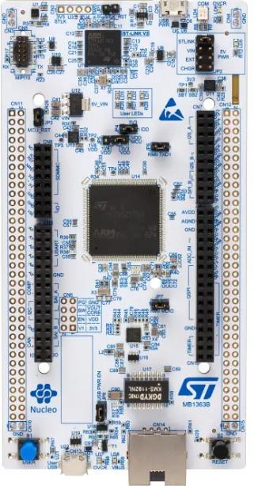
ABOUT STM32H755ZIQ
The STM32 Nucleo board is a development board series from STMicroelectronics designed for rapid prototyping with STM32 microcontrollers. These boards provide an affordable and flexible way to experiment with:
STM32 MCUs
offering Arduino Uno
ST morpho
The NUCLEO-H755ZI-Q is a high-performance STM32 Nucleo board based on the STM32H755ZIQ microcontroller, which features dual-core architecture.
This STM board supports with a ST Link Driver.

Slide 6
PROPOSED ONE
To develop an intelligent air quality monitoring system to detect pollutants and chemicals that affect plant growth in urban agriculture. Our strategy introduces an essential element by tracking air quality in real-time, which has a direct impact on urban crop development.
Air Quality Sensor -PM2.5 Sensor - Measures small particles that can affect photosynthesis.
CO2 Sensor – Detects excessive CO2 levels that may impact plant respiration.
NOx Sensor – Monitors nitrogen oxides, which can be harmful to crops.
Implementation Strategy Sensor Calibration and Integration - Connects the sensor to the accuracy of the STM32 and test data.
Data Processing and Storage - Store real-time data for trend analysis and insights.
Communications Module - Send real-time data to cloud-based systems for remote monitoring. The user interface is to develop a panel of farmers panels to access contamination levels and recommendations.
Testing and Optimization - Optimization based on deployment and outcomes in urban farm conditions. Expected BenefitsEarly detection of harmful contaminants affecting crops.
Real-time alerts and recommendations for city urban farmers. Improvement of decision -making and sustainable agriculture. Evolution - can be extended using additional sensors (for example, soil quality, humidity).

Slide 7
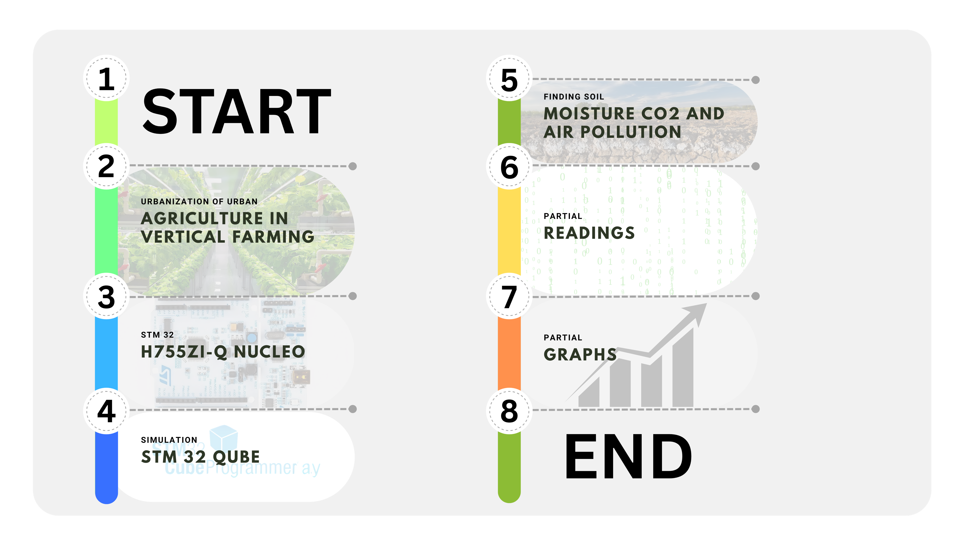
BLOCK DIAGRAM

Slide 8
HW AND SW USED
Hardware:
STM32H755ZIQ Board
PM 2.5 Sensor (Air pollution Detection)/MQ135 (Instead)
Co2 Sensor
Soil moisture sensor
ST Link driver
Software:
Fritzing
STM32 Cube IDE
Think Speak

Slide 9
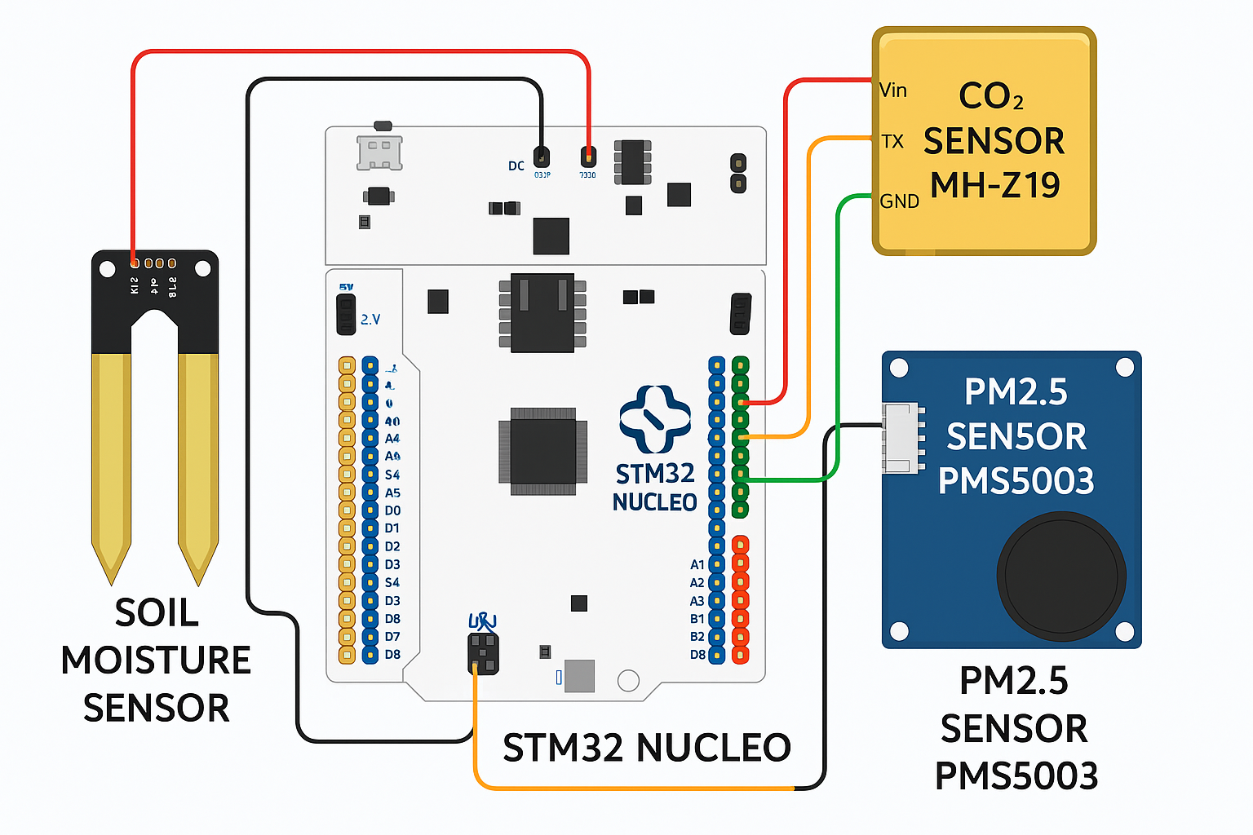
SAMPLE CONNECTION DIAGRAM

Slide 10
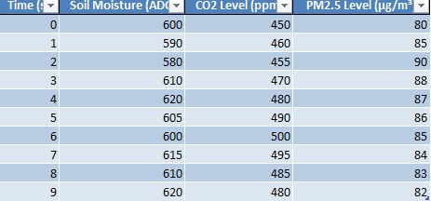
SAMPLE READINGS

Slide 11
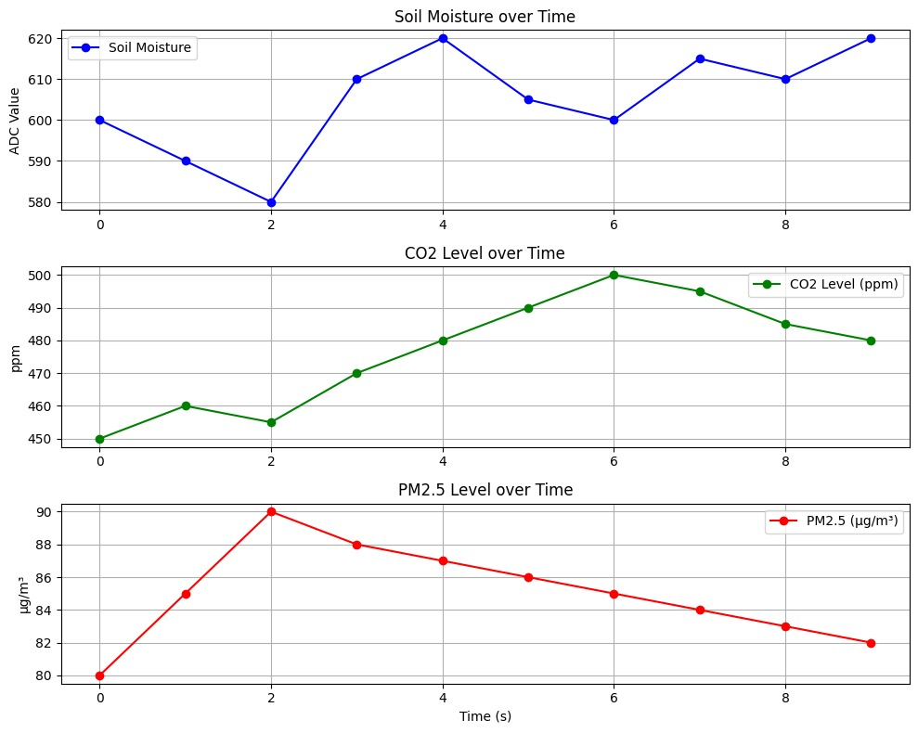
GRAPH

Slide 12
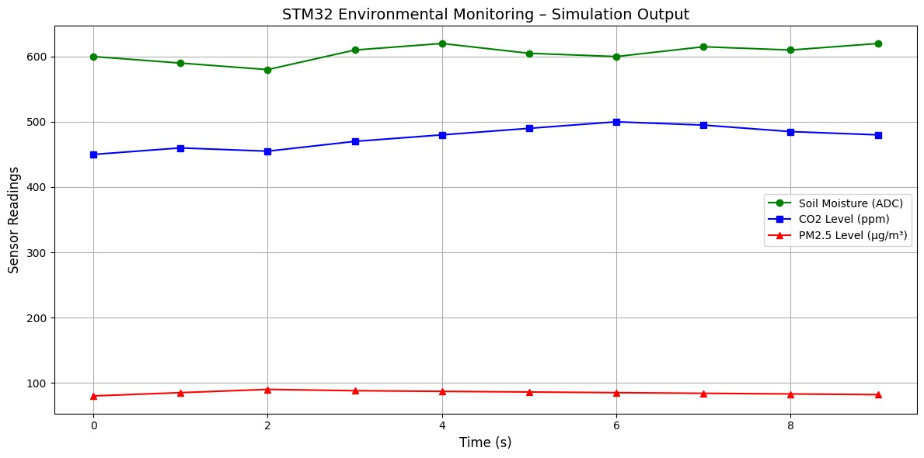
GRAPH

Slide 13


